Slide 1

High-speed Downstream Plasma Jet Generated due to Shock Reformation Savvas Raptis Co-authors : T. Karlsson (KTH), A. Vaivads (KTH), C. Pollock (Denali Scientific), F. Plaschke (Technische Universität Braunschweig), A. Johlander (IRF, Uppsala), H. Trollvik (KTH), P-A. Lindqvist (KTH) 8th MMS Community Workshop 10/05/2022

Slide 2
Introduction

Slide 3
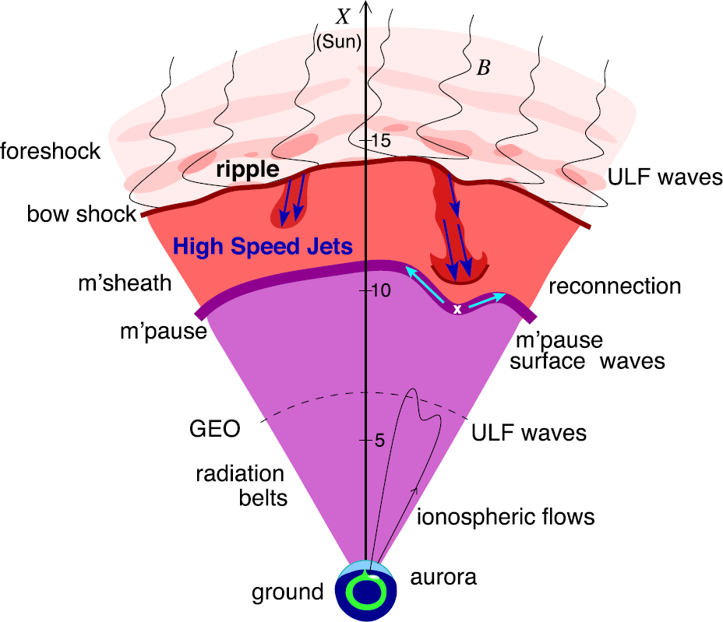
Magnetosheath Jets – Definition
Definition
Magnetosheath jets are transient localized enhancements of dynamic pressure (density and/or velocity increase)
e.g., 200% dynamic pressure enhancement compared to background magnetosheath
Related phenomena
Radiation belts
Throat aurora
Magnetopause reconnection
Magnetopause penetration
Shock acceleration
Magnetopause surface eigenmodes
ULF waves
Plaschke F. et al. (2018); sketch by H. Hietala | Space Sci. Rev

Slide 4
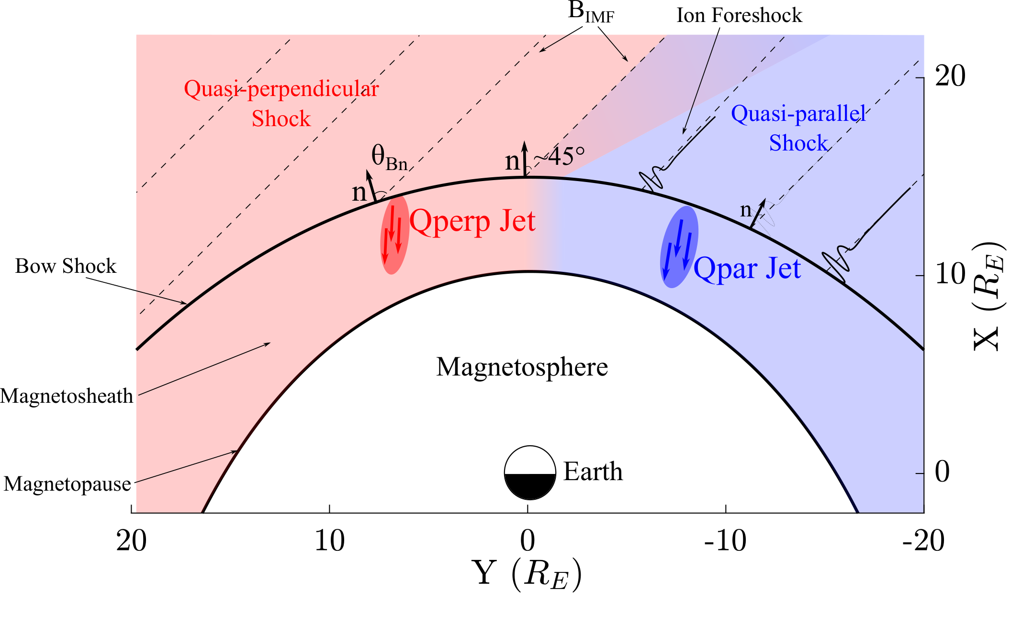
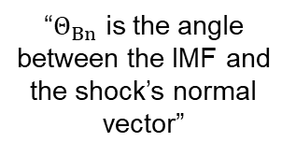
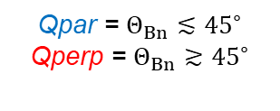
Shock, Magnetosheath & Jet classification
“$Θ_{Βn}$ is the angle between the IMF and the shock’s normal vector”
Qpar = $Θ_{Βn}≲{45}^{∘}$
Qperp = $Θ_{Βn}≳{45}^{∘}$
”Jets found ~9 times more often in the Qpar MSH”
Vuorinen et al. (2019)
Raptis, Karlsson, et al. (2020) | JGR
Raptis, Aminalragia-Giamini et al. (2020) | Front. Astron. Space Sci
Karlsson, Raptis et al. (2021) | JGR
Kajdič, Raptis et al. (2021) | GRL

Slide 5
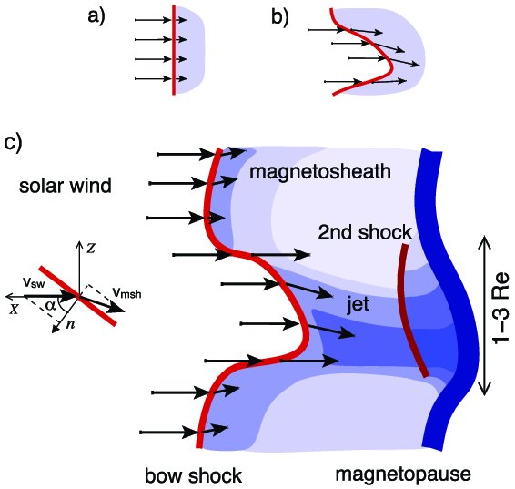
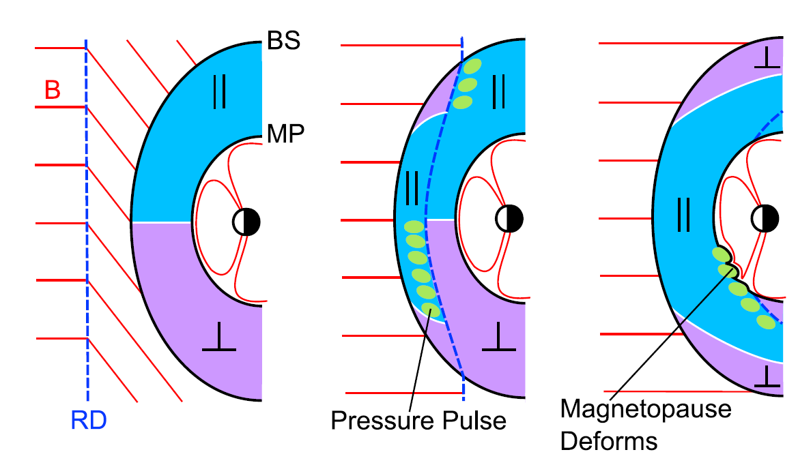
How are these jets created ?
Shock ripples
SW discontinuities
Foreshock Structures
Hietala et al. (2009,2012)
Archer et al. (2012)
Karlsson et al.(2015), Suni et al. (2021), Raptis et al. (2022)
Notes:
SW → locally inclined part of the bow shock → less deceleration and heating

Slide 6
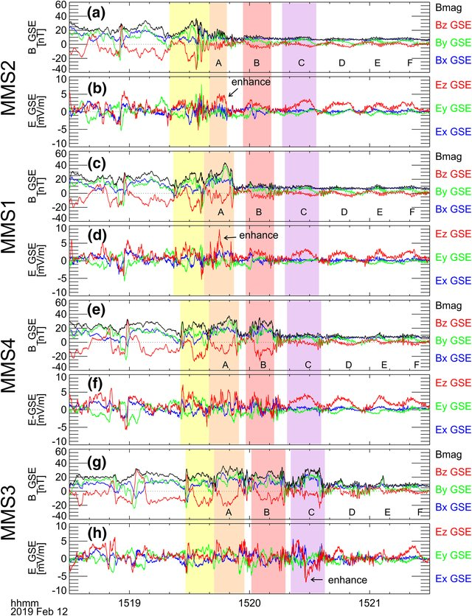
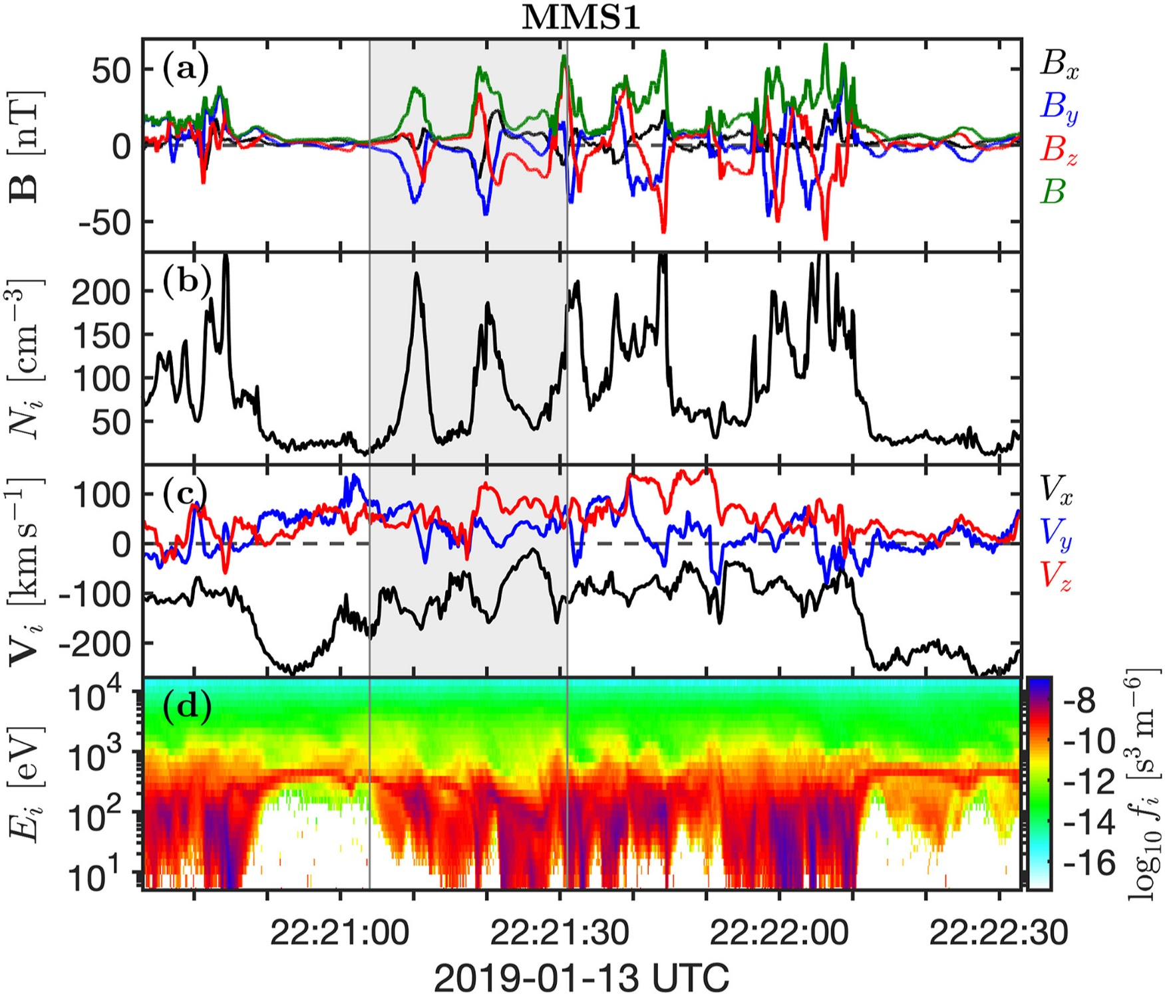
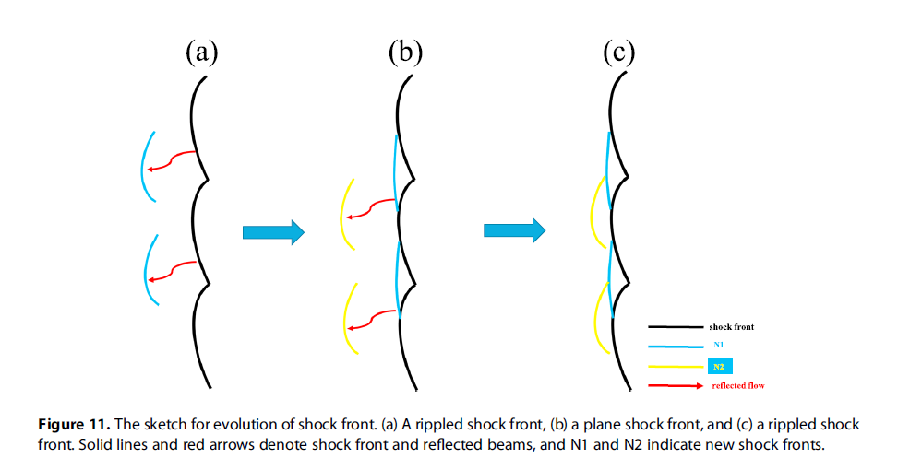
Shock Reformation
Shock Reformation
Burgess (1989): “the shock exhibits a cyclic behavior ….. cyclic shock reformation;”
Hao et al. (2017)
Liu et al. (2021)
Johlander et al. (2022)

Slide 7
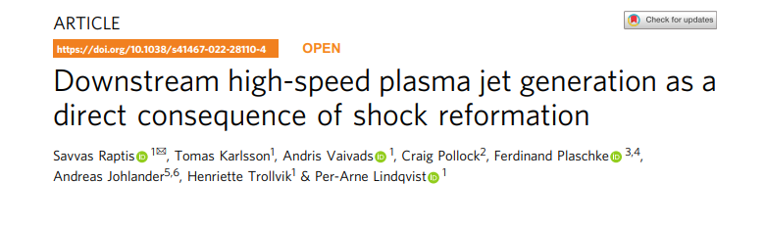
Raptis, S., Karlsson, T., Vaivads, A. et al. Downstream high-speed plasma jet generation as a direct consequence of shock reformation. Nat Commun 13, 598 (2022). https://doi.org/10.1038/s41467-022-28110-4

Slide 8
Results
MMS Data | Schematic

Slide 9
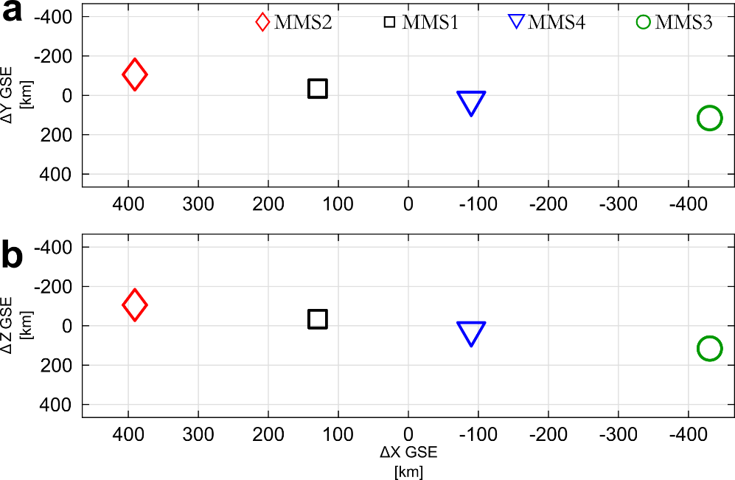
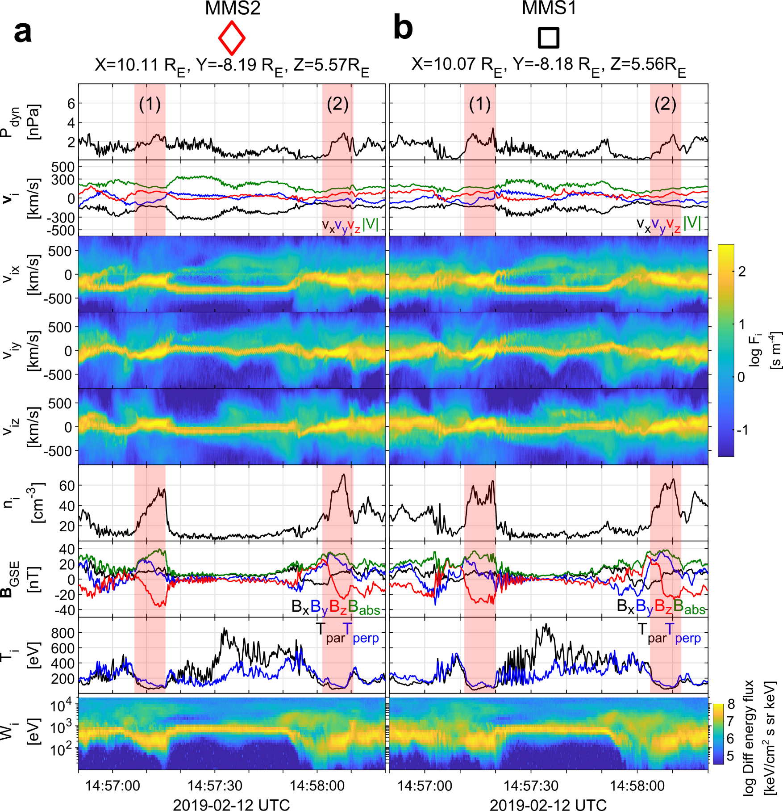
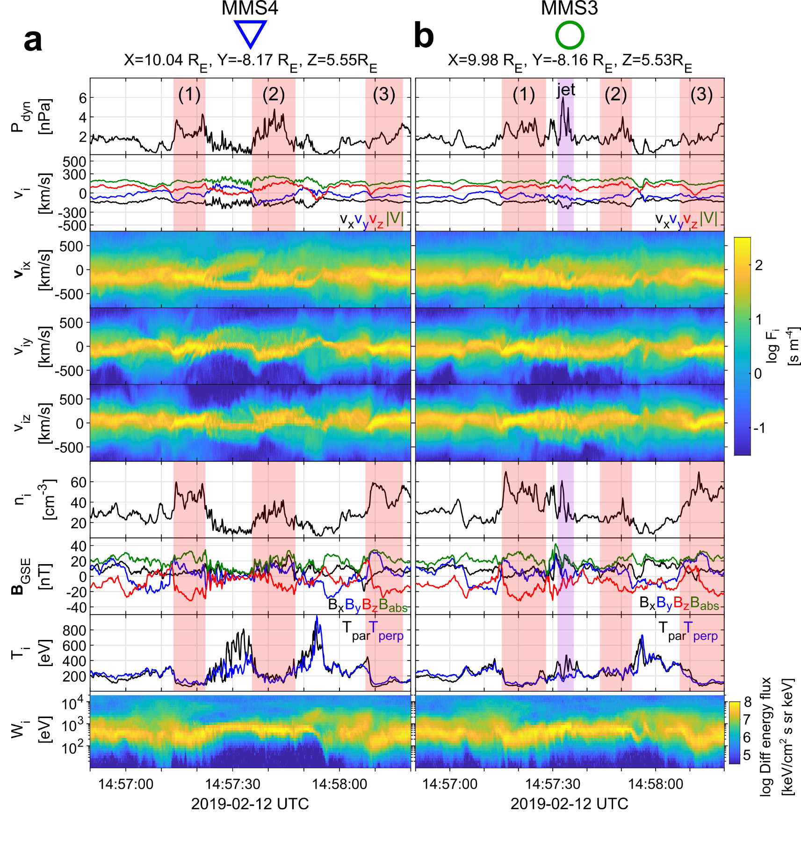
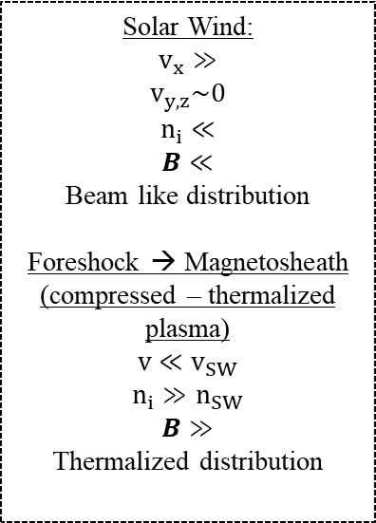
General Observations of MMS
u
d
Solar Wind:
$$v_{x}≫$$
$$v_{y,z}\sim 0$$
$$n_{i}≪$$
$$B≪$$
Beam like distribution
Foreshock → Magnetosheath
(compressed – thermalized plasma)
$$v≪v_{SW}$$
$$n_{i}≫n_{SW}$$
$$B≫$$
Thermalized distribution

Slide 10
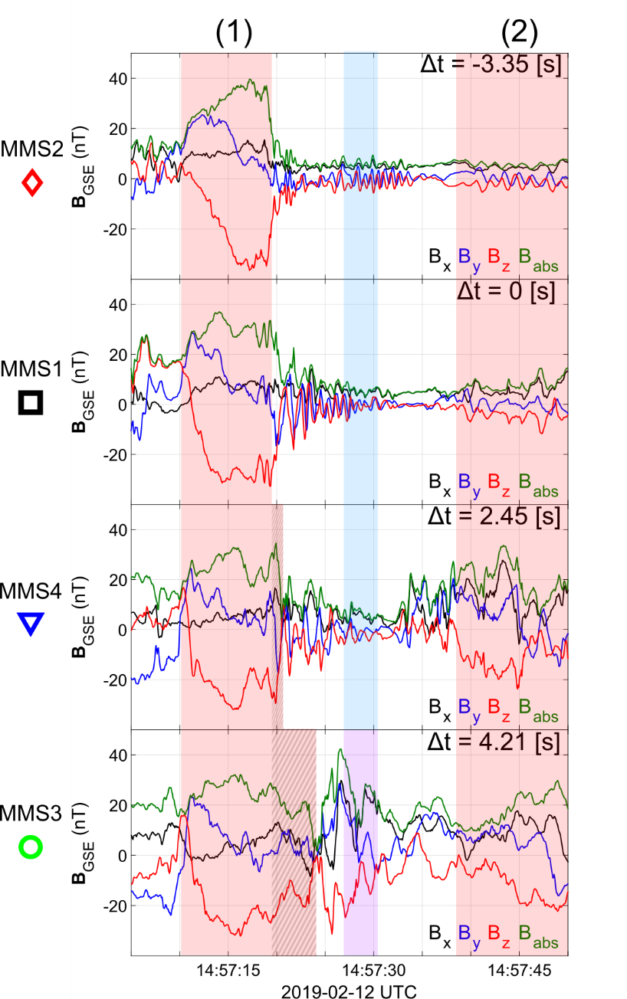

SLAMS & wave activity co-moving picture
Evolution of SLAMS
Interaction with upstream whistler
New peak /evolution*
Formation of embedded plasmoid (downstream density enhancement)**
* See similar examples by Turner et al. (2021), Chen et al. (2021)
** See similar example by Liu et al. (2021)

Slide 11
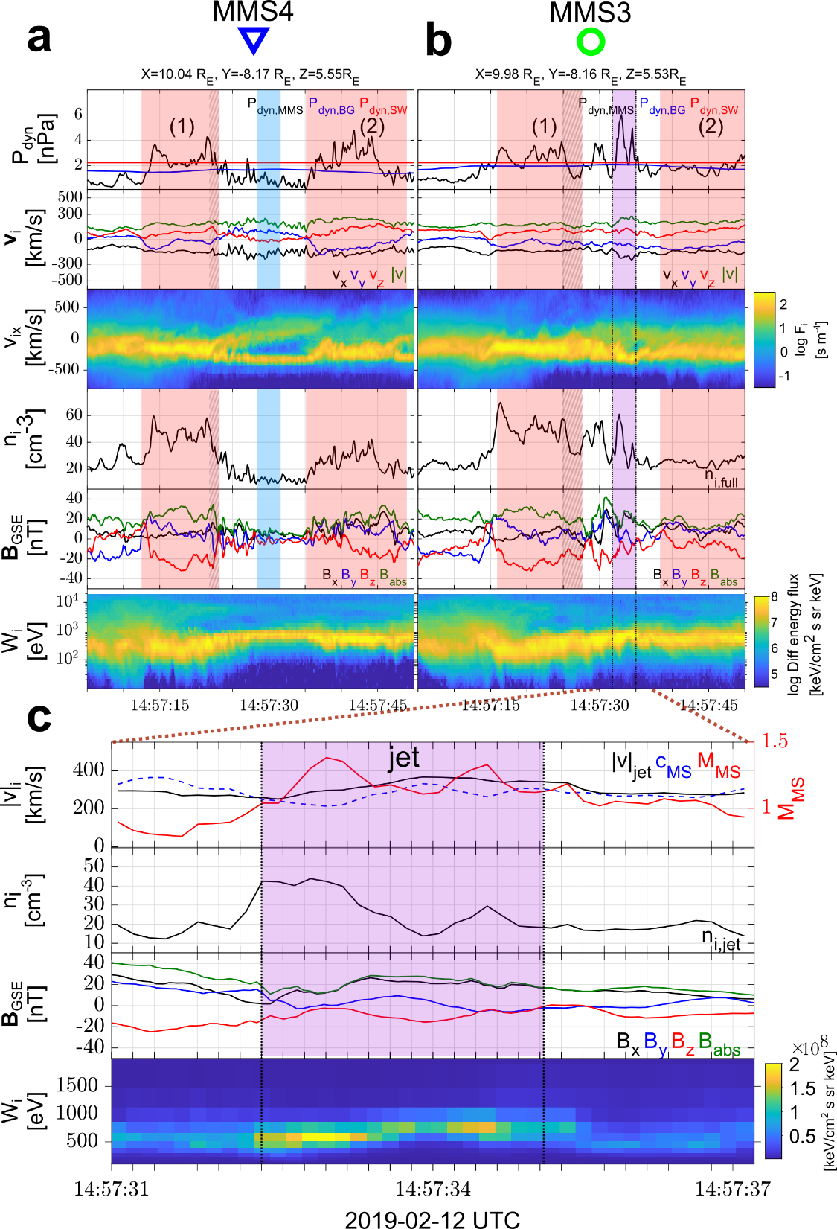
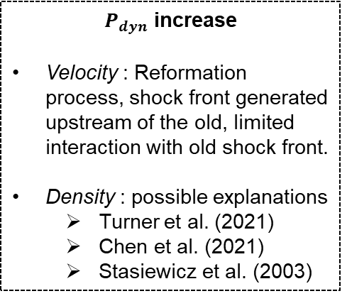
MMS inner-spacecraft observations
$P_{dyn}$ increase
Velocity : Reformation process, shock front generated upstream of the old, limited interaction with old shock front.
Density : possible explanations
Turner et al. (2021)
Chen et al. (2021)
Stasiewicz et al. (2003)

Slide 12
Results
MMS Data | Schematic

Slide 13
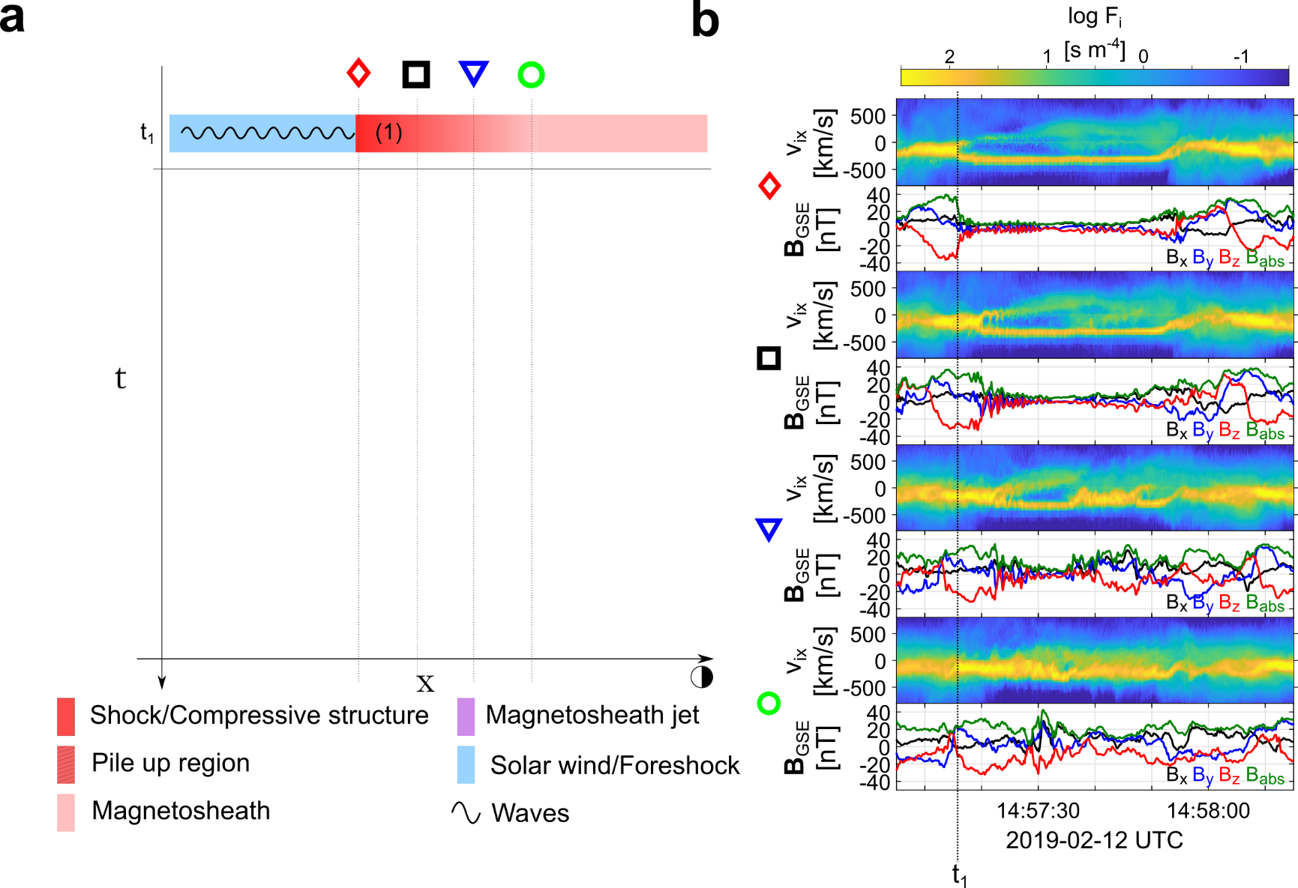
Formation mechanism

Slide 14
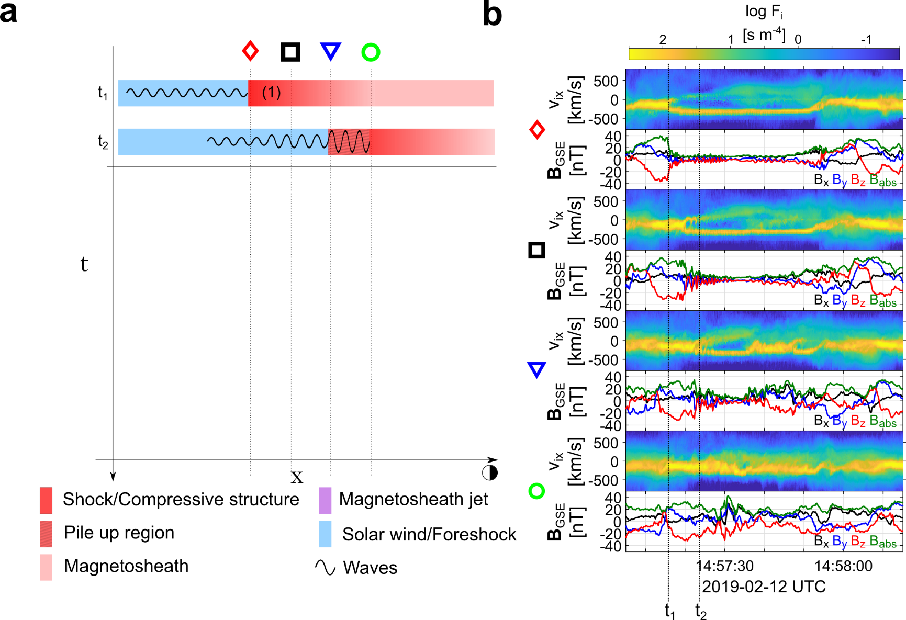
Formation mechanism

Slide 15
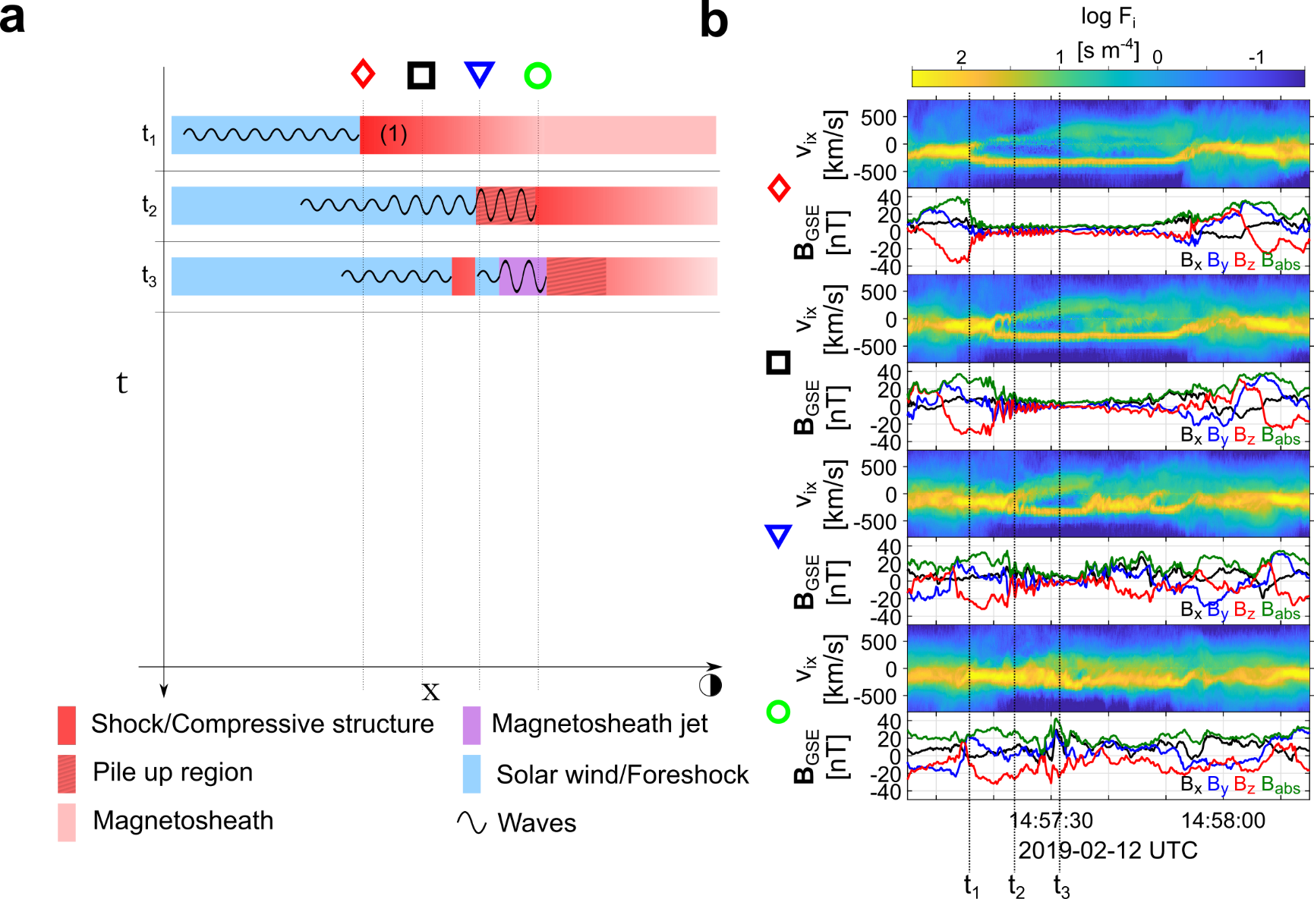
Formation mechanism

Slide 16
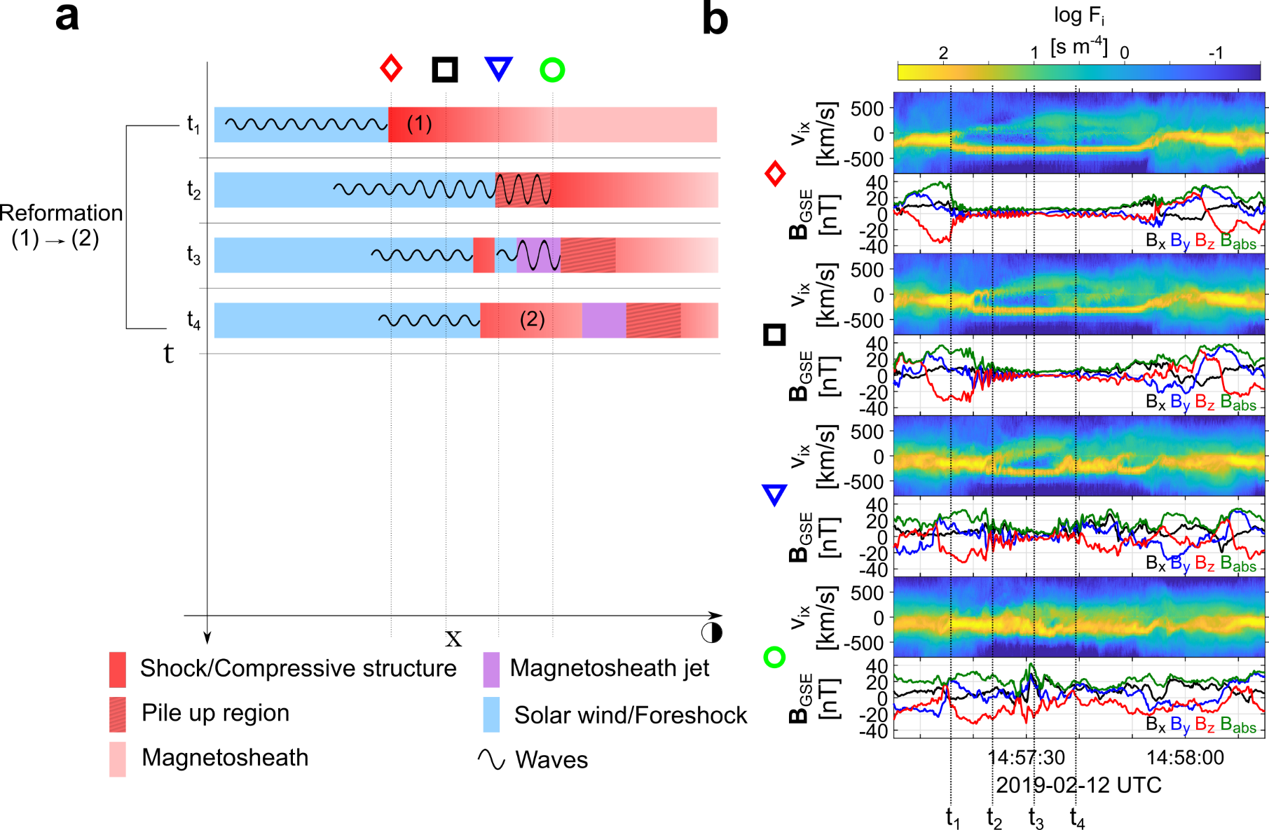
Formation mechanism

Slide 17
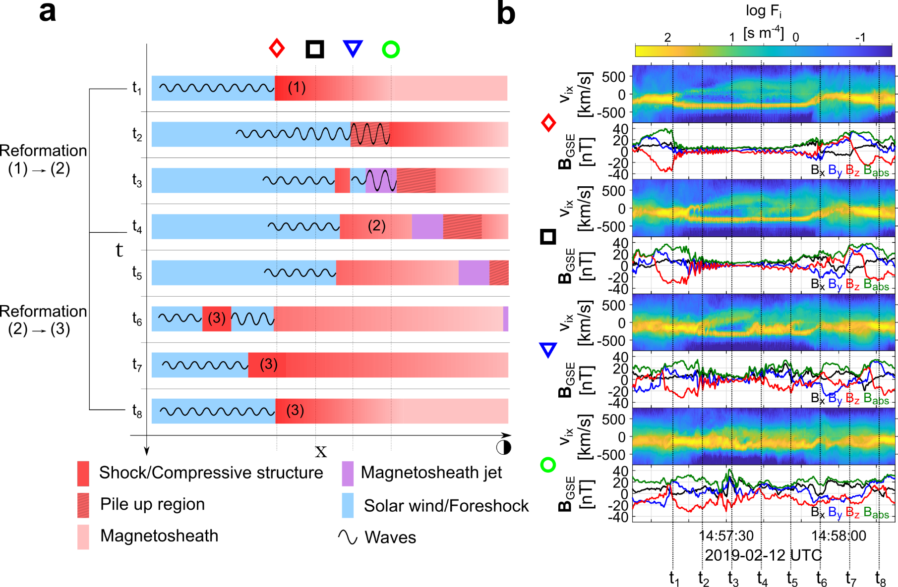
Formation mechanism

Slide 18


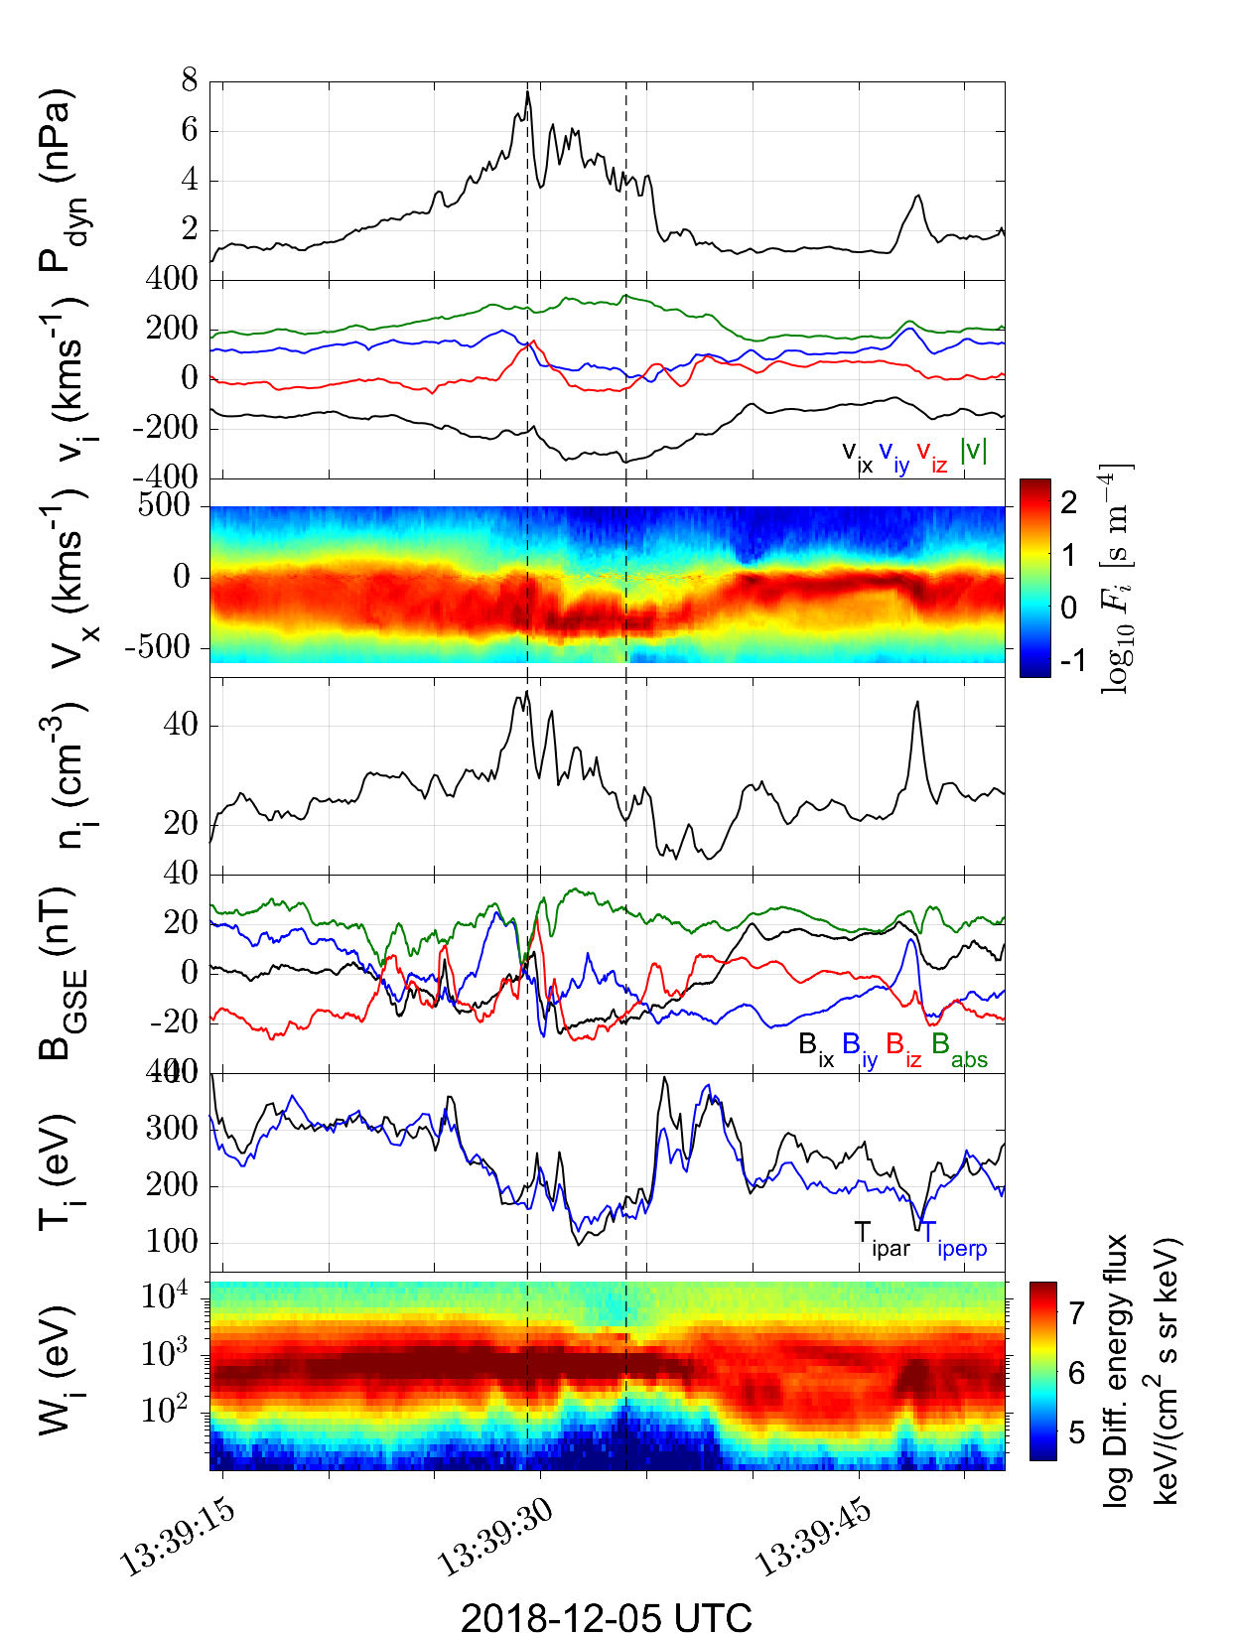
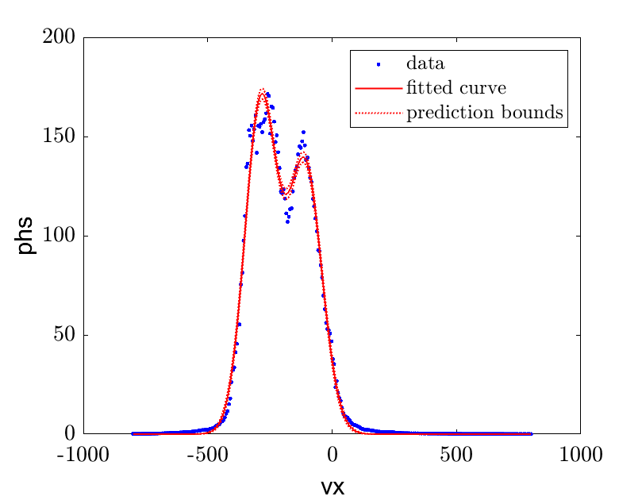
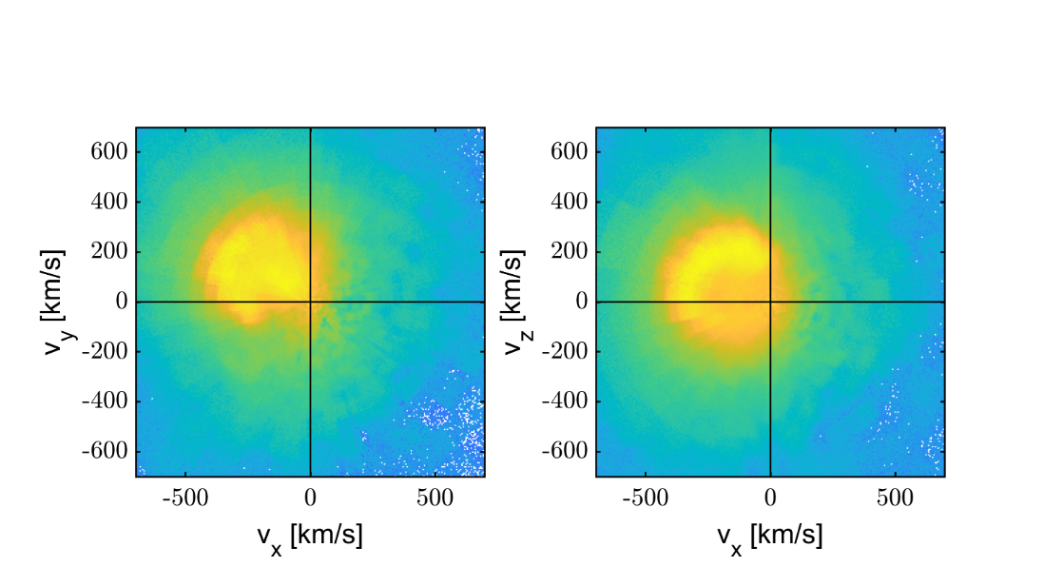
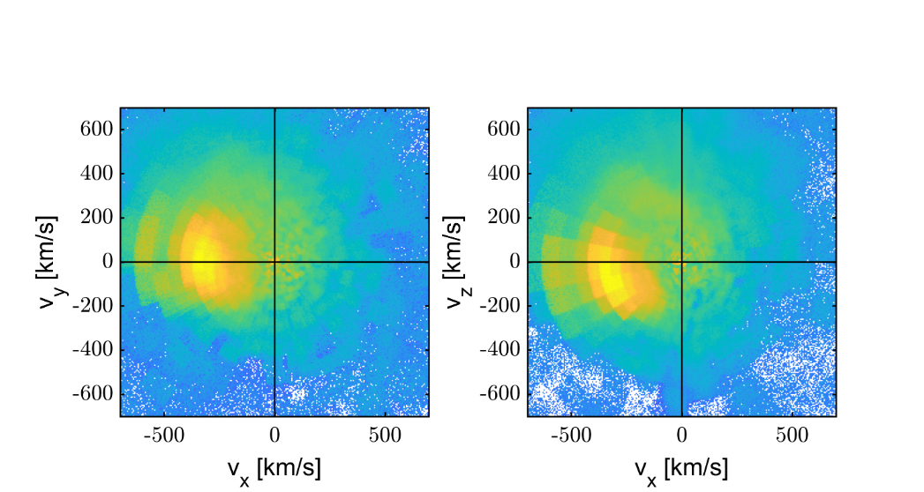
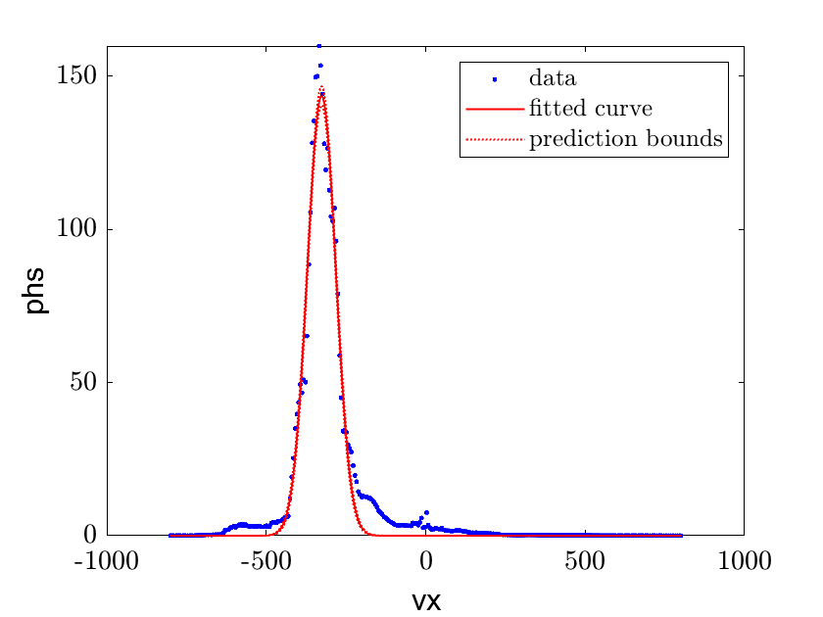
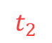
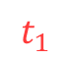
Ongoing results
$$t_{1}$$
$$t_{2}$$
How jets develop after the shock ? How do they interact with the Background ?
Integrated 1D Vx
Integrated 2D VDFs
Raptis, Karlsson et al. (2022 - Ongoing)

Slide 19
Summary & Conclusion
Main points
In-situ observations of SLAMS becoming “embedded plasmoids” (density enhanced downstream regions).
in-situ observations of jets forming through the dynamical evolution of collisionless shock (reformation)
Open Questions
Details on SLAMS/waves – Exact properties & evolution study of FCs numbered 1-3 (TBD)
Simulation comparison – Can we find cases like these in simulations (ongoing) ?
Statistics – We need more events, currently found ~3 with similar signatures (TBD).
Modeling – Can we explain jets close to MP ? How long do these jets “survive” in the MSh ? (ongoing)
Morphology & Evolution – What’s their interaction with the background ? How their properties vary ? (ongoing)

Slide 20
Extras

Slide 21
Extras

Slide 22
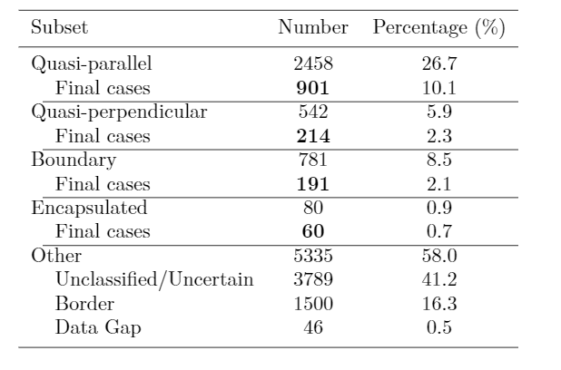
MMS – Jet Database
Fast/Survey
Burst
9/2015 - 9/2020
Jets with full burst data
Qpar | 423
Qperp | 34
Boundary | 35
Encapsulated | 31
Close to BS / MP | 495
Others | 428
Raptis S., Karlsson T., et al. (2020) | JGR
Raptis S., Aminalragia-Giamini S., et al. (2020) | Frontiers
Palmroth M., Raptis S., et al. (2021) | Annales
Kajdic P., Raptis S., et al. (2021) | GRL
Raptis S., Karlsson T., et al. (2022) | Nat. Commun
Raptis S., Karlsson T,, et al. (2022) | Ongoing

Slide 23
Jets – references update (>2019)
Associated phenomena & effects
Excitation of surface eigenmodes at magnetopause: Archer et al. (2019, 2021)
Mirror mode waves and jets : Bianco-Cano et al. (2020)
Bursty magnetic reconnection at the Earth's magnetopause : Ng et al. (2021)
Ground-based magnetometer response : Norenius et al. (2021)
Generation of Pi2 pulsations : Katsavrias et al. (2021)
B in jets, Bz variations near magnetopause : Vuorinen et al. (2021)
Modeling & formation
Velocity & magnetic field alignment in jets : Plaschke et al. (2020)
Classification of jets using MMS & Neural Networks : Raptis et al. (2020a,2020b)
Comparison MMS vs simulations : Palmroth et al. (2021)
Solar wind effect on jet formation : LaMoury et al. (2021)
Magnetosheath Jets and Plasmoids - Hybrid Simulations : Preisser et al. (2020)
Formation of jets in Quasi-perpendicular magnetosheath : Primoz et al. (2021)
Jets Downstream of Collisionless Shocks
Plaschke et al. (2018)
https://link.springer.com/article/10.1007/s11214-018-0516-3
And more : Liu et al. (2020a,2020b), Omelchenko et al (2021), Sibeck et al. (2021), Suni et al. (2021), Tinoco-Arenas et al. (2022) … etc. etc.

Slide 24
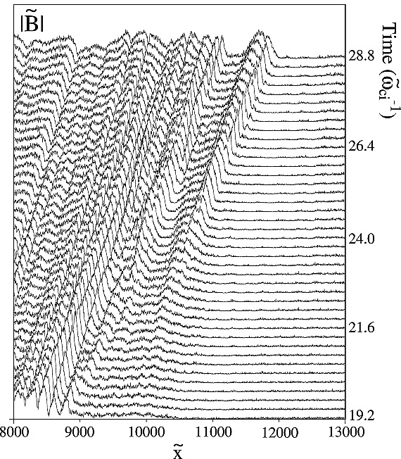
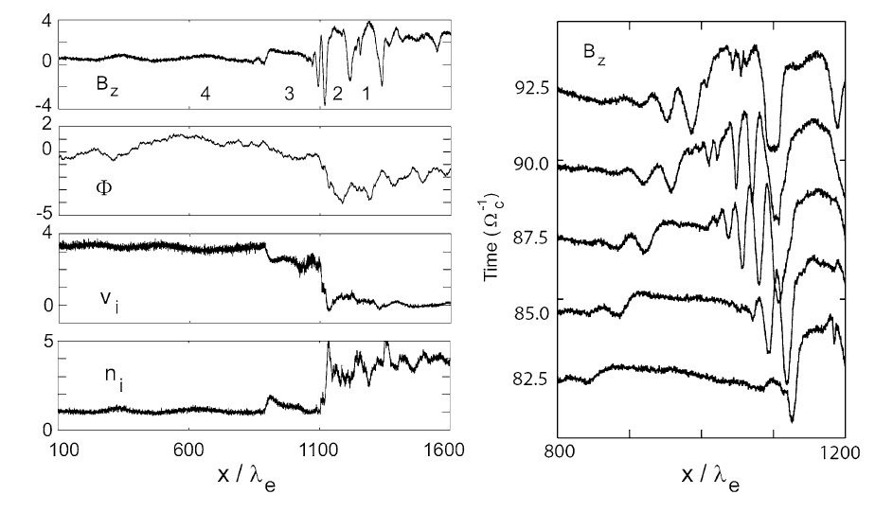
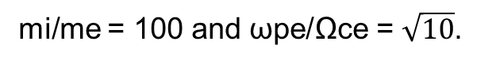
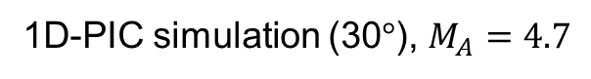
Shock Reformation – Simulations
1D-PIC simulation (30$°$), $M_{A}=4.7$
mi/me = 50 and ωpe/Ωce = 4.
mi/me = 100 and ωpe/Ωce = $\sqrt{10}$.
Scholer et al. (2003) | JGR
Tsubouchi & Lembège (2004) | JGR
More nice sources for review : Burgess & Scholer (2015), Willson (2016)
Notes:
Scholer : MA = 4.7 shock with a mass ratio of mi/me = 100 and ωpe/Ωce = √10 are shown in Fig. The total system size for this simulation is 200c/ωpi.

Slide 25
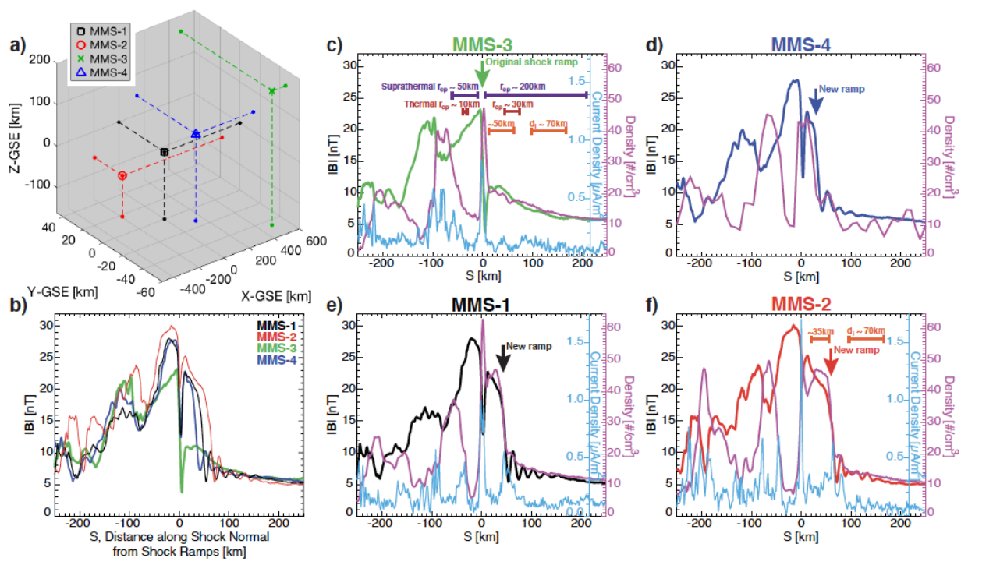
Turner et al. 2021 (local reformation/evolution)

Slide 26
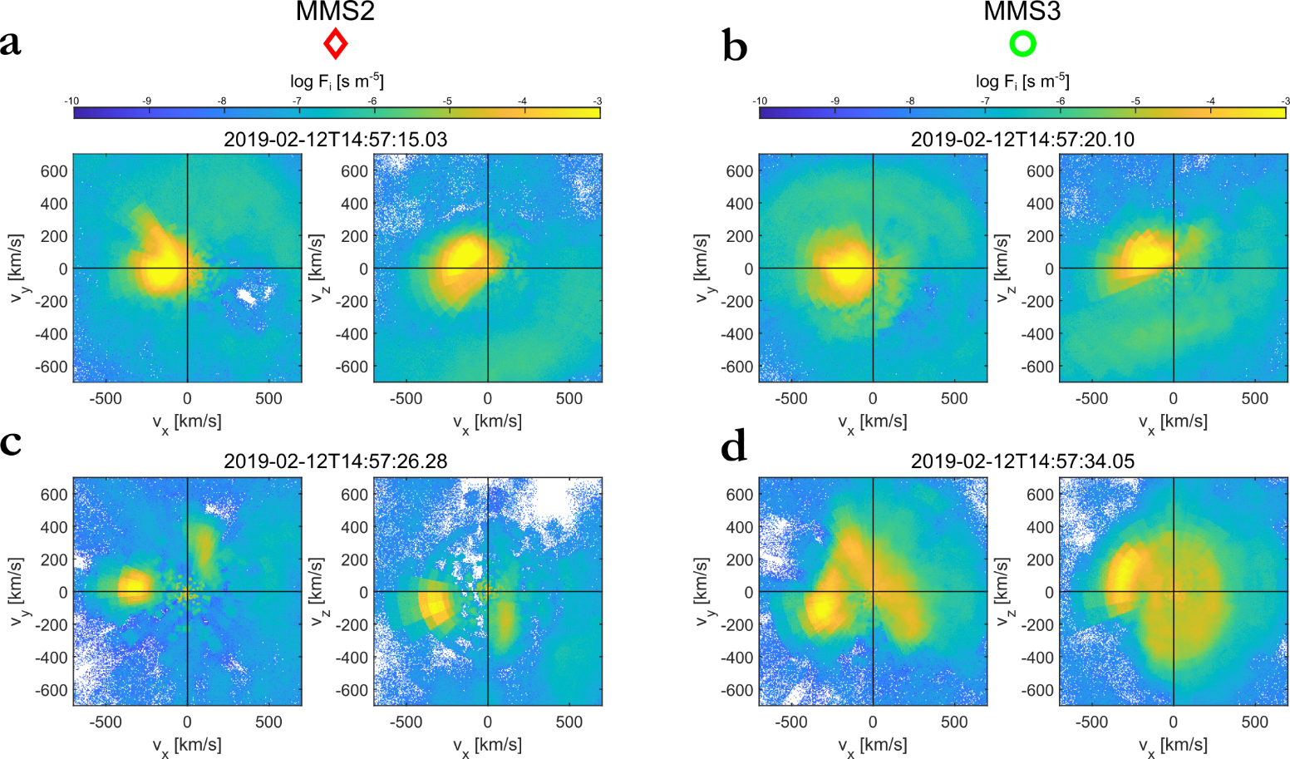
VDFs

Slide 27
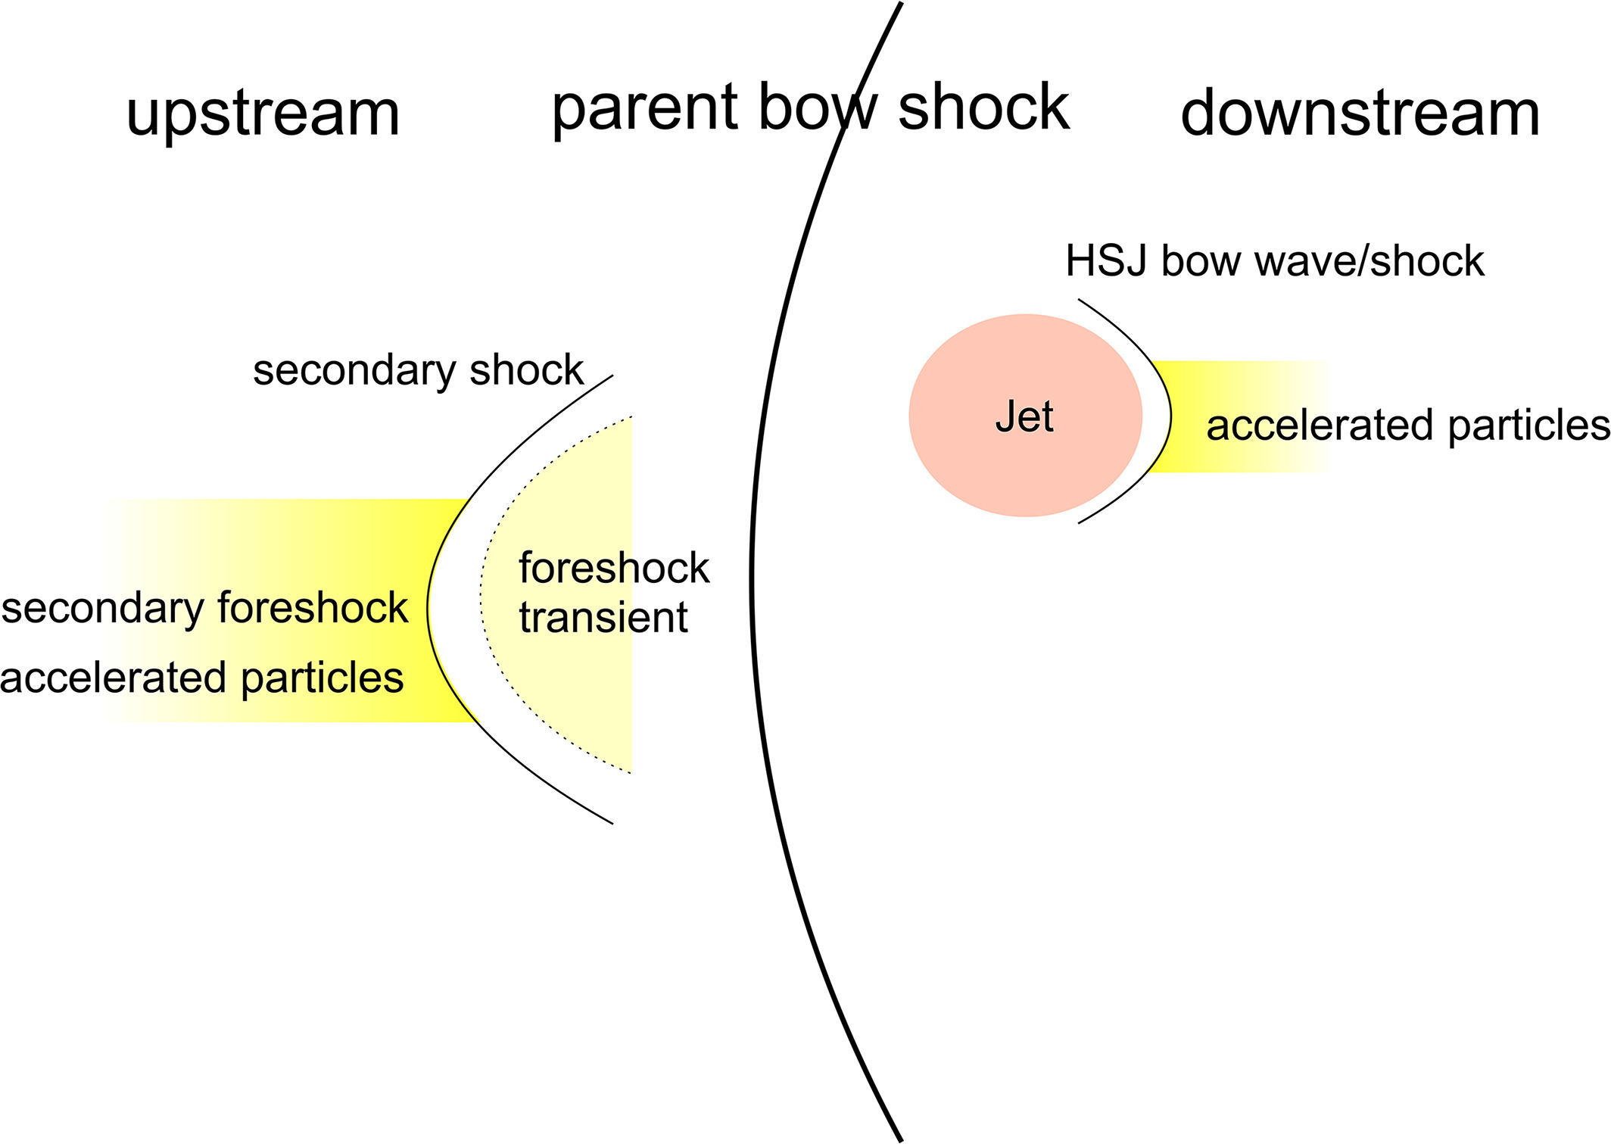
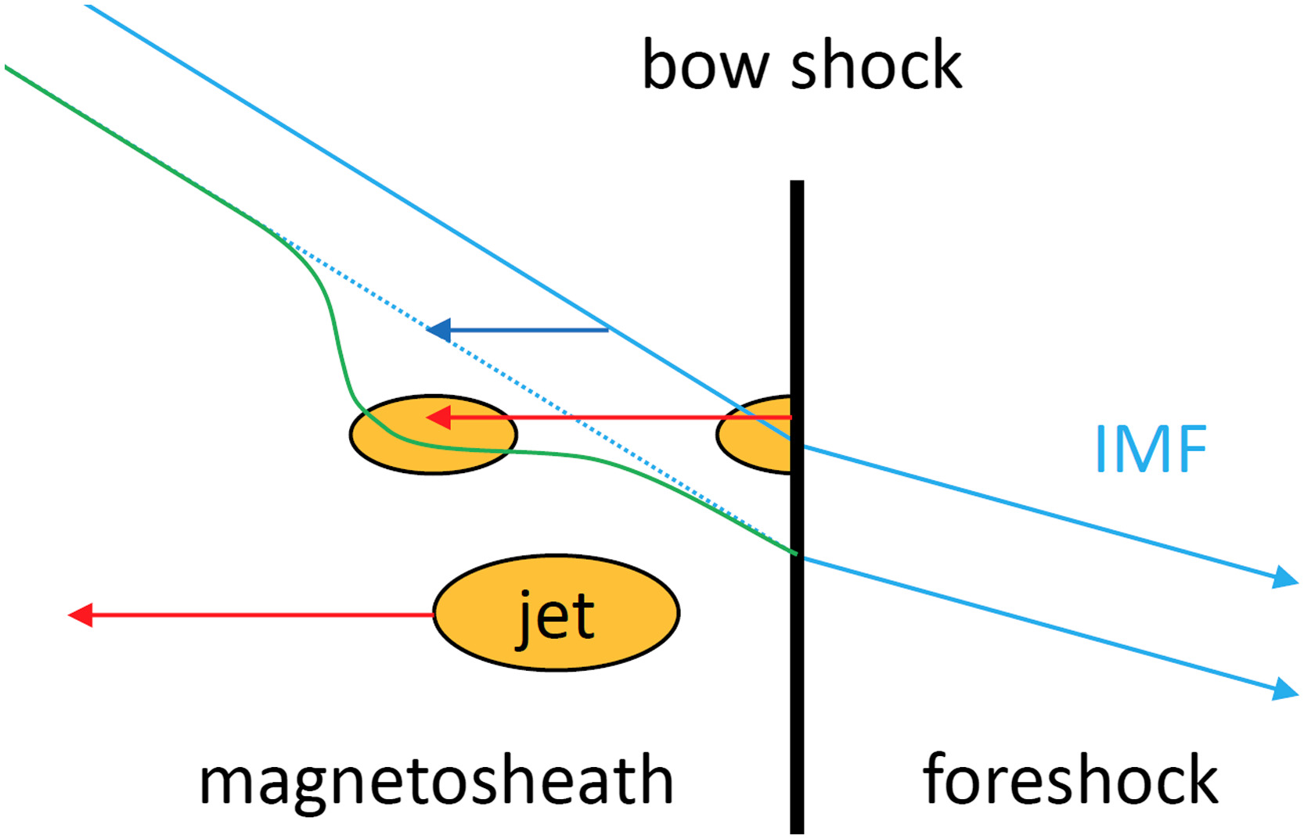
Jets interaction with ambient plasma
Liu et al. (2020)
Plaschke et al. (2018,2020)

Slide 28

Fast/Survey MMS data
Burst MMS data
Resolution (samples/s)
Resolution (samples/s)
FGM (magnetic field):
FPI (plasma moments | ions):
EDP (electric field):
0.0625
4.5
0.0313
0.0078
0.15
0.00012218
Pros
Always available
Decent resolution
Can be good for statistics due to availability
Pros
Very high resolution
Able to resolve structures close to boundary surfaces (e.g. mix of plasma close to magnetopause, bow shock, foreshock etc.)
Cons
Not available all the time, mostly available close to vital mission objectives (magnetopause, diffusion regions, shock transitions etc.)
Hard to do proper large scale statistics due to biases generated from specific availability and manual choice of intervals
Cons
Not suitable for small scale studies
Could be misleading close to boundary surfaces (Magnetopause, Bow shock etc.)
More information: Baker, et al. (2016) | Space Sci Rev 19

Slide 29
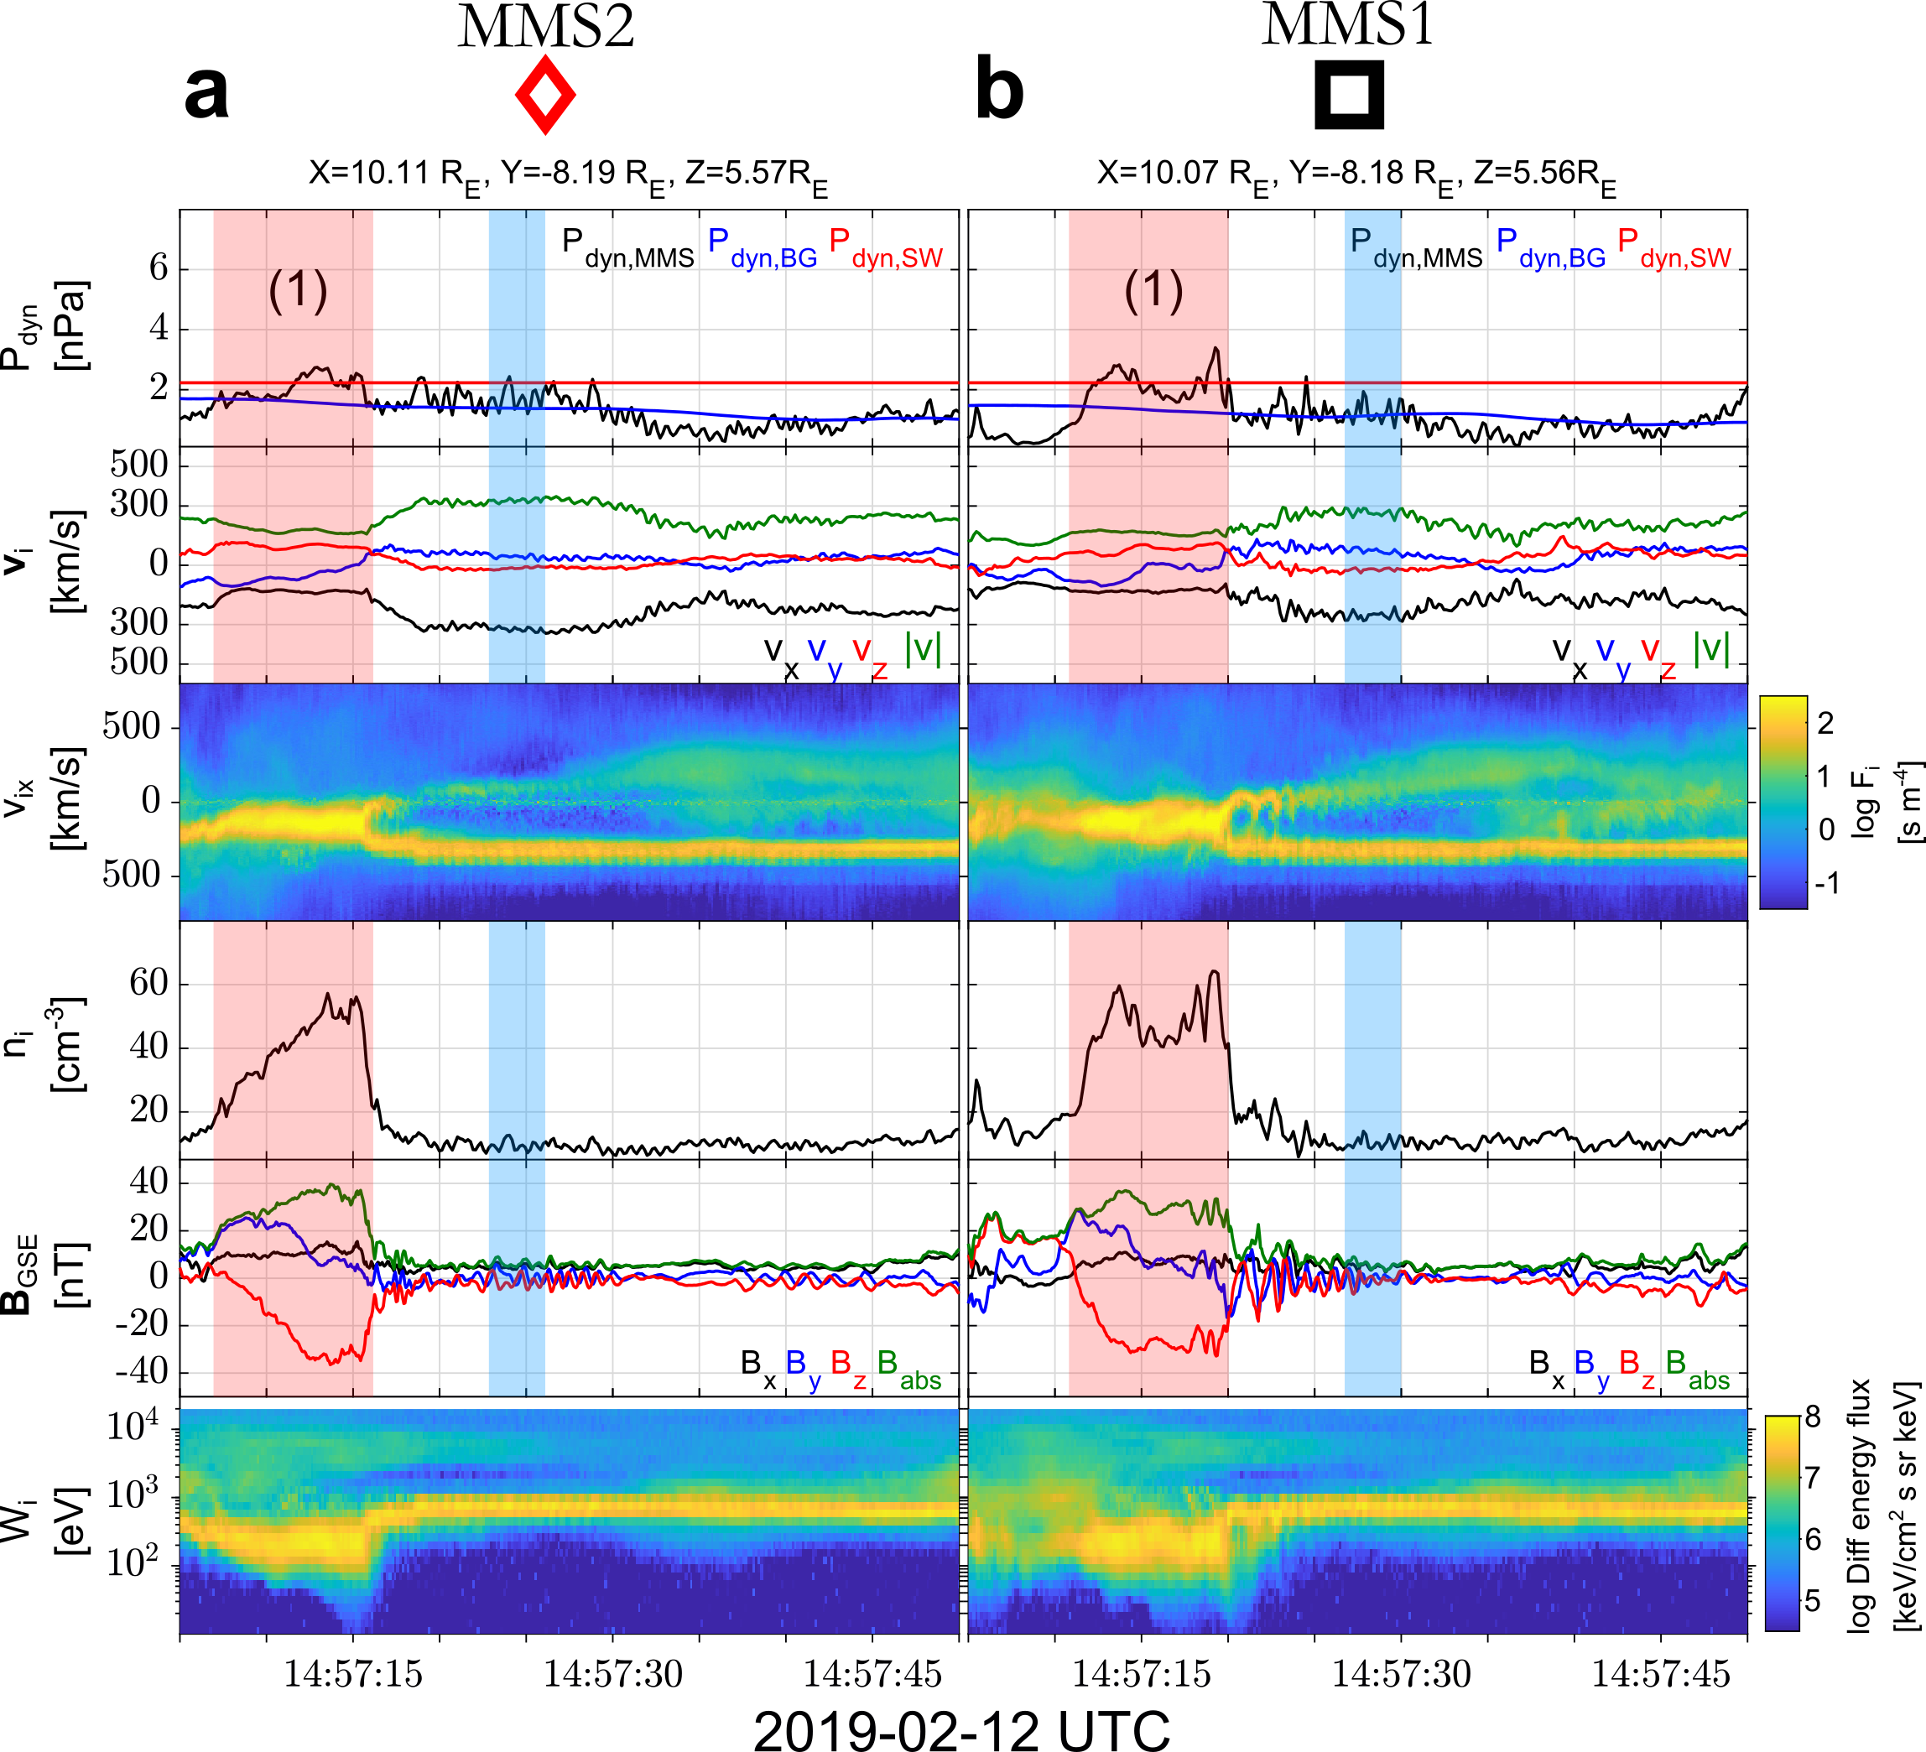
MMS outer-spacecraft observations

Slide 30
Boundary Jet – Typical Examples with MMS
Dynamic Pressure
(nPa)
Dynamic Pressure
Ratio
velocity
enhancement
Velocity
(km/s)
density
enhancement
Density
(cm⁻³)
Magnetic Field
(nT)
Differential Ion Energy
Spectrum (eV)
Ion Temperature
(eV)
Raptis, Karlsson, et al. (2020) | JGR

